Slide 1


CSE 470 – V Model
BRAC University

Slide 2


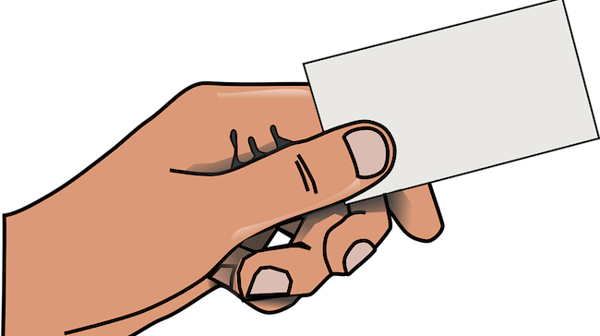
Small Accounting Project
Team Lead

Slide 3


Requirement is Rigid.
Customer asked to emphasize on proper testing of the accounting software…..!!!

Slide 4
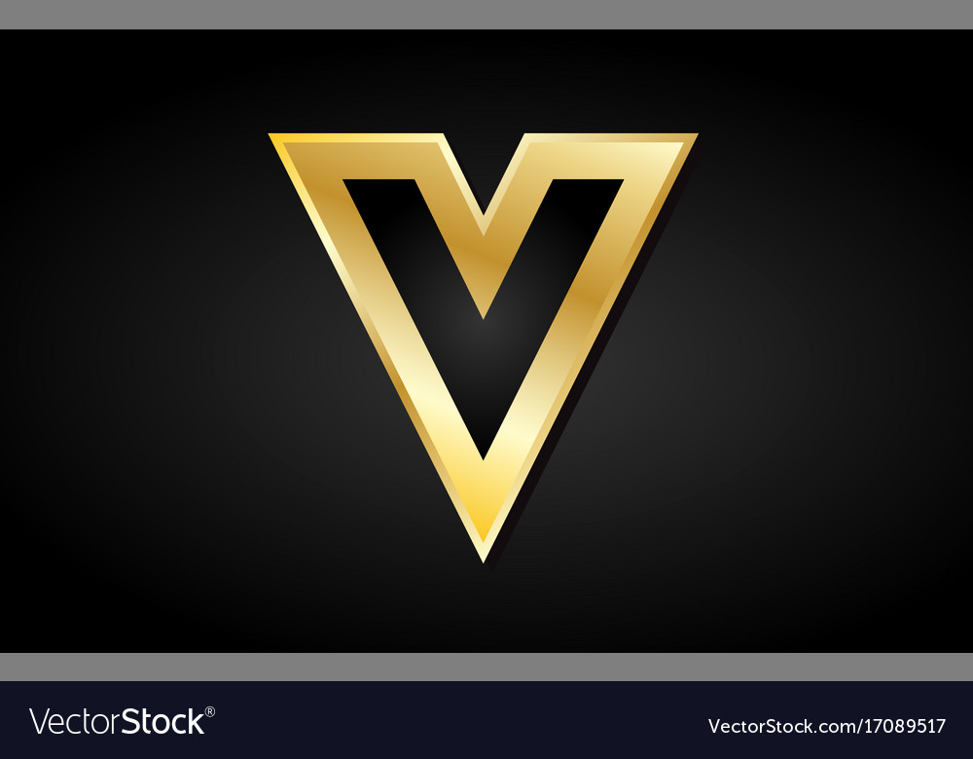
V-Model
Its another sequential software development process model. Its also known as an extension of waterfall model, due to providing earlier and detailed software testing.

Slide 5

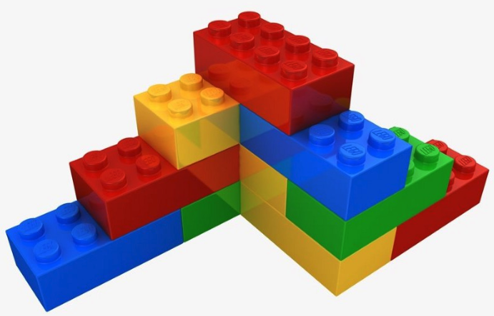
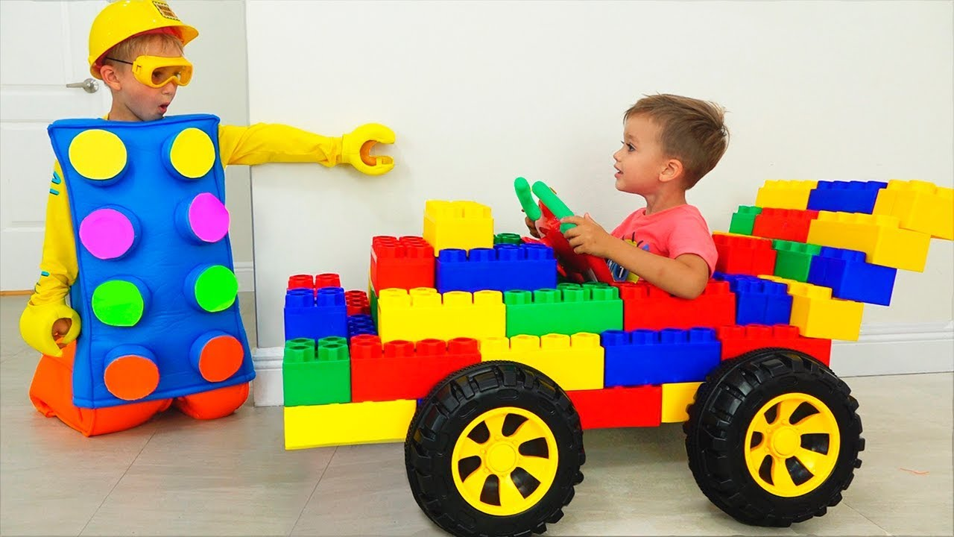
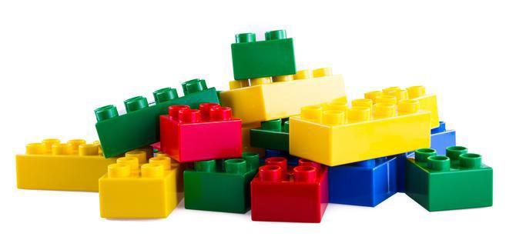

Acceptance
Test Design
Requirement Analysis
Acceptance Testing
System
Test Design
Architecture Design
System Testing
Integration
Test Design
Component/Module Design
Integration Testing
Unit Test Design
Code Generation
Unit Testing

Slide 6
Verification and Validation
Suppose, you have received a request for developing a android app. In this regard, you meet the customers, collected requirements, documented the requirements, created designs to built it and finally coded it as per the design. That means you are trying to follow all standard ways to develop the app rightly.
Building the product in the right way is called “Verification”.
Verification
Validation
After completion of the app coding, we sent it to testing phase. Various tests are performed to ensure whether the app meets the customer requirements. That is you try to check whether the right app is developed.
Building the right product is called “Validation”.

Slide 7
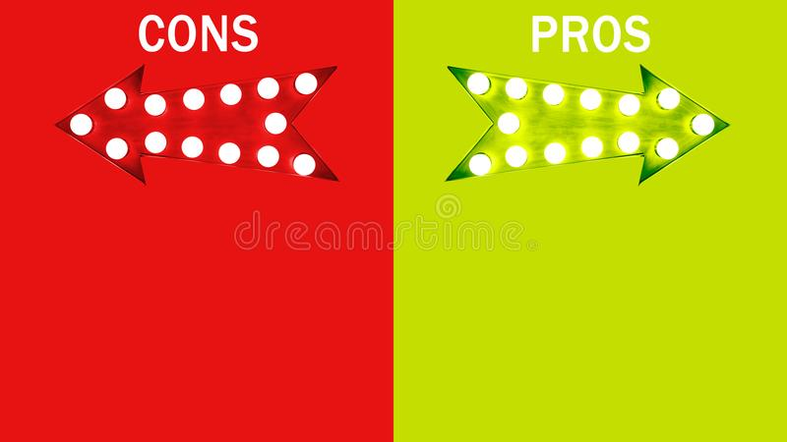
Along with waterfall advantages, it emphasizes planning for verification and validation (V&V) of the product from the very beginning of requirement collection.
Test activities planned before testing
Saves time over waterfall, higher chance of success because of testing each of the phases individually.
Changes are not welcomed
Software developed at end of all phases, so no dummy prototypes can be found
If any test fails, then test document and code both needs to be updated

